Slide 1

Breast Cancer Prediction Using Machine Learning Algorithms
Team Members: Dinesh Bhogadi Veena Ravuri Kota Sai Teja Jana

Slide 2
Introduction
In this project we have implemented the below algorithms
Support vector machine
K-NN algorithm
Gaussian NB.
Neural Networks
RandomForestClassifier
DesicionTreeClassifier
Logistic Regression

Slide 3
Background work
An enormous number of deaths worldwide are brought on by breast cancer
. Numerous data science (DS) techniques work in conjunction with new technologies to aid in the evaluation and collection of data based on cancer in order to forecast this deadly disease
Among these DS technologies, machine learning algorithms have been used to analyze data related to cancer
The use of machine learning classifiers has reduced human error and provided quick, in-depth analysis of medical data . For data modeling and prediction, there are a number of machine learning classifiers available; in our work, we used the support vector machine (SVM), logistic regression (LR), k-nearest neighbor (KNN), Gaussian NB, DecisionTreeClassifier, and RandomForestClassifier for breast cancer prediction.

Slide 4
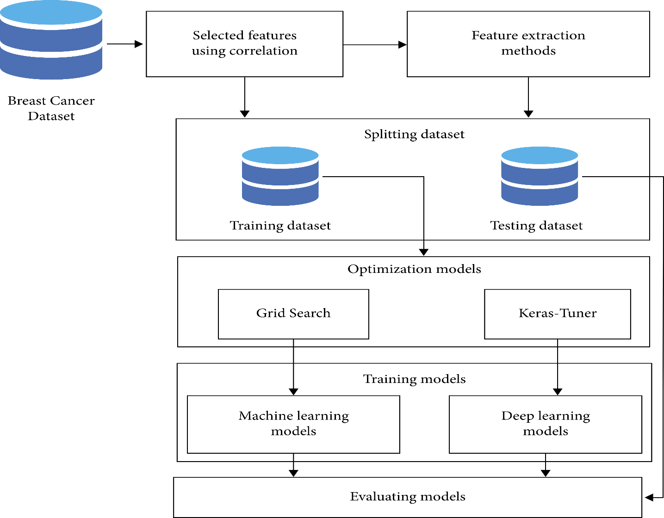
Model Explanation:
Architecture Diagram

Slide 5
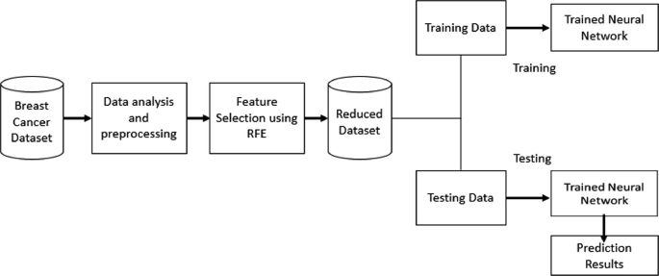
Workflow diagram

Slide 6
Dataset
Brief Explanation :
We used Breast Cancer Wisconsin (Diagnostic) Data Set. This is an open-source dataset can be downloaded from Kaggle.
Information on 569 women across 32 different qualities can be found in the dataset.
Data is available in the csv file is from a digital image of a fine needle aspirate (FNA) of a breast mass, features are calculated
An exhaustive search in the domain of 1-4 features and 1-3 separation planes was used to select relevant feature
The first group of variables is Mean (3–13), followed by Stranded Error (1–23) and Worst (23–32), each of which has ten parameters. Mean, Standard Error, and Worst all refer to the average of all the cells, respectively

Slide 7
Features
In this data set we have 569 rows and 32 columns .
.There are total of benign 357 and malignant 212 values
There are some real value features that can be calculated from each cell nuclei
Radius which is the mean of distances from center to points on the perimeter
Texture which is the standard deviation of gray-scale values.
Perimeter which is the perimeter of the cell
Area is the total area of the contour
Smoothness which is the local variation in radius lengths
Compactness can be calculated using ((perimeter)^2/area -1)
Concavity is the severity of concave portions of the contour
Concave points are the number of concave portions of the contour
Symmetry is defined as the symmetry as the contour

Slide 8
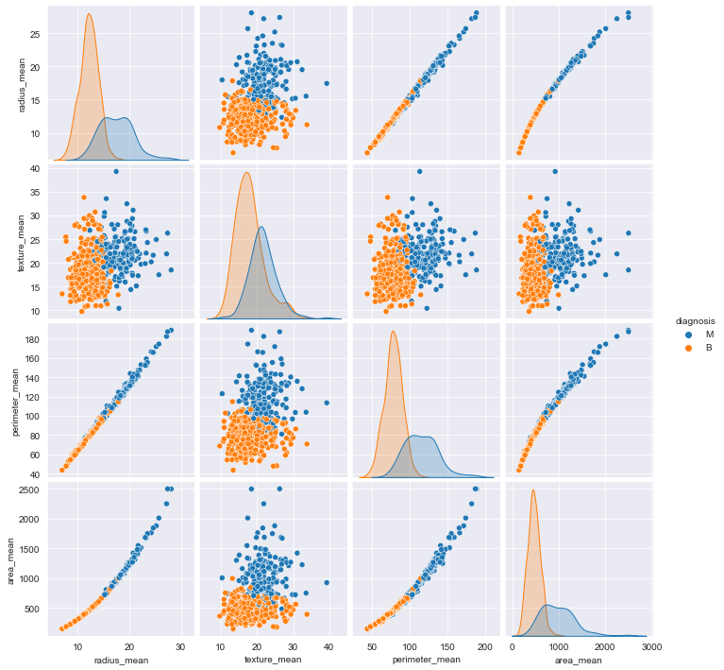
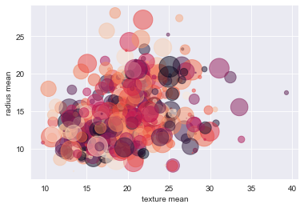
Data visualization

Slide 9
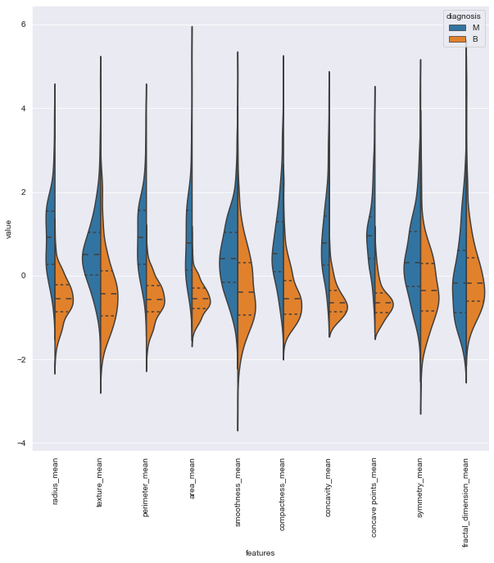
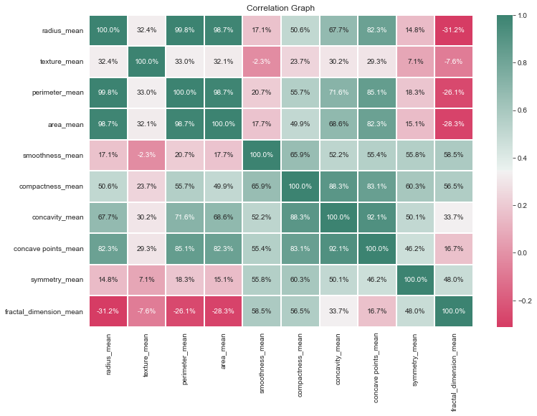
Data visualization

Slide 10
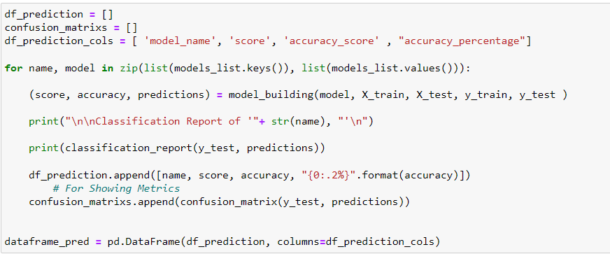
Model Implementation

Slide 11
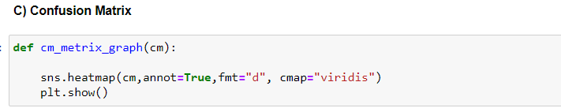
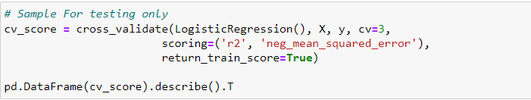
Model Implementation
Confusion Matrix
Applying K-Fold

Slide 12
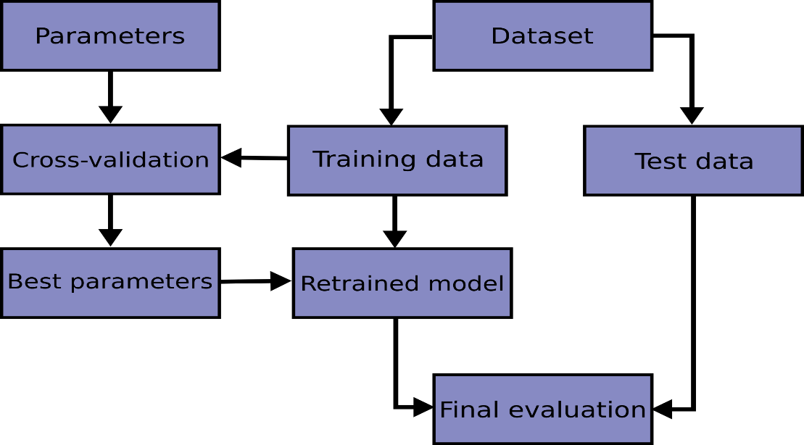
Model Implementation
Cross Validation

Slide 13
Model Implementation
Hyper tuning
To find the ideal values for a given model, hyperparameter tuning is done using the Grid Search method.
This is important because the values supplied for the hyperparameters determine how well the entire machine learning model performs.
Model hyperparameters are characteristics of a model that are external to the model and whose value cannot be deduced from data.
The hyperparameter's value must be set before the learning process can begin. On the other hand, the value of a parameter can be calculated from data and is an inherent aspect of the model.
The support vectors in SVMs or the beta coefficients of logistic or linear regression. While viewing the model, we can observe the algorithm in action.

Slide 14
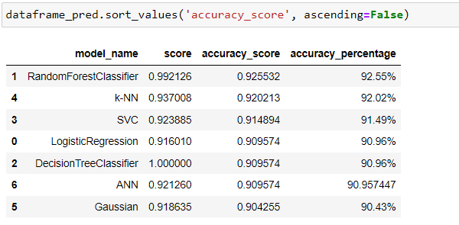
Results
For comparing the results, we have stored the modelname, test score of the algorithm, accuracy score and the accuracy percentage in a data frame. From the accuracy_score
we can see that RandomForestClassifier has higher accuracy when compared to other models, followed by K-NN and SVC. The accuracy score of Logistic regression, DecisionTreeClassifier and ANN are nearly same with an value of 0.909. The Gaussian NB has least accuracy with an accuracy of 90.43%.
Below is the image showing results with accuracy score in ascending order

Slide 15
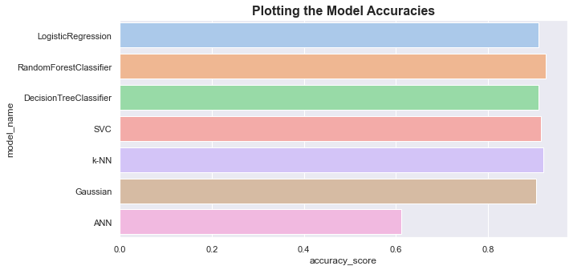
Results
Plotting bar graph using accuracy score

Slide 16
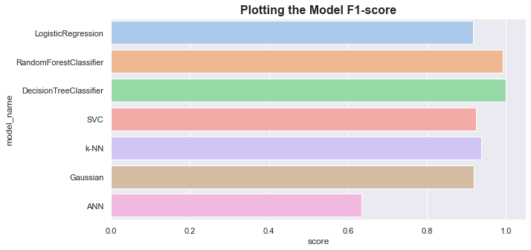
Results
Plotting bar graph using F1-score

Slide 17
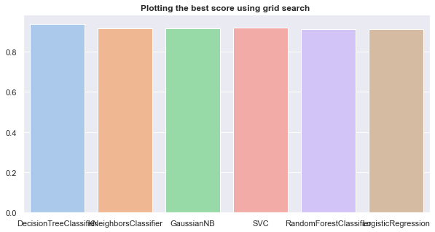
Results
Plotting bar graph using Grid search

Slide 18
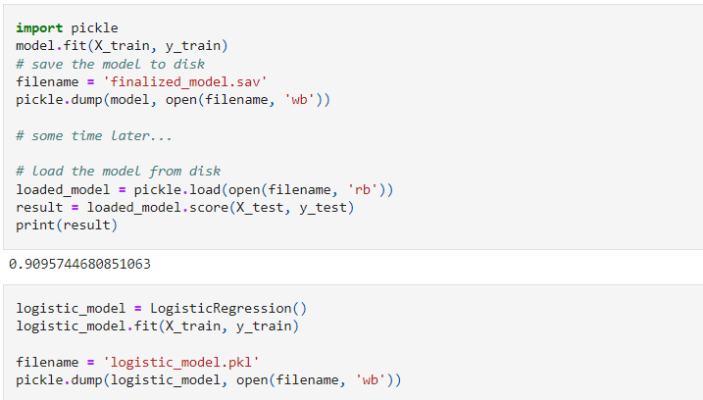
Deploy the model
We have completed our work thus far. The deployment of our model in the production map is the final phase.
Therefore, we must export our model and tie it to an API for a web application. With Pickle, we can export our model and store it in a model.pkl file that we can easily retrieve and use the Web App API to compute customized predictions.
Sample code for using pickle is shown below. The result will give the accuracy of algorithm

Slide 19
Thank You

